Slide 1



Designing Assembly for MET
Fernando Coronado
Mentors:
Christopher Walker
Ruben Dominguez
Siddhartha Sirsi

Slide 2
Meissner Effect Transistor (MET)
The Meissner Effect uses superconductors and magnets to do essentially what Field Effect Transistors do.
Transistors are building blocks for microchips. For a sense of scale, the A10 chip in the iPhone 7 has 3.3 billion transistors.
The MET has the potential to be faster and be more densely packed than current transistors, because there will potentially no heat given off.
I was tasked with designing an assembly for the proof of concept testing of the MET.

Slide 3
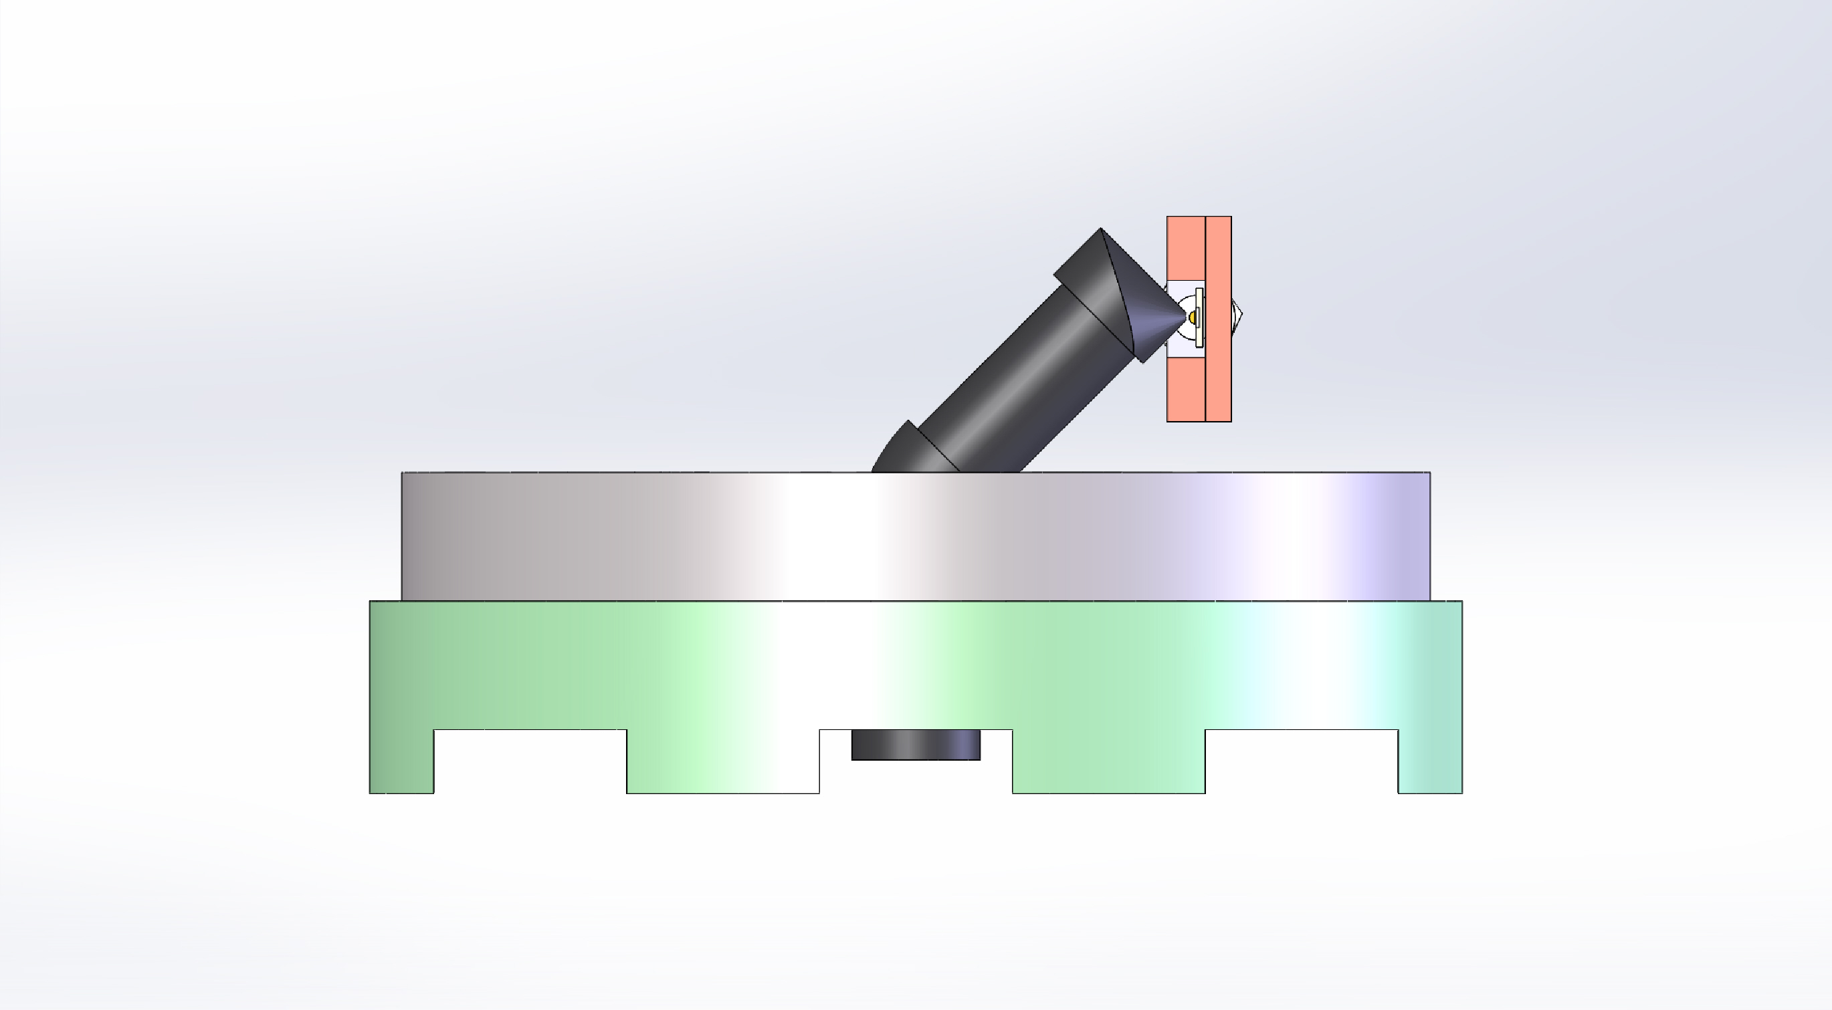
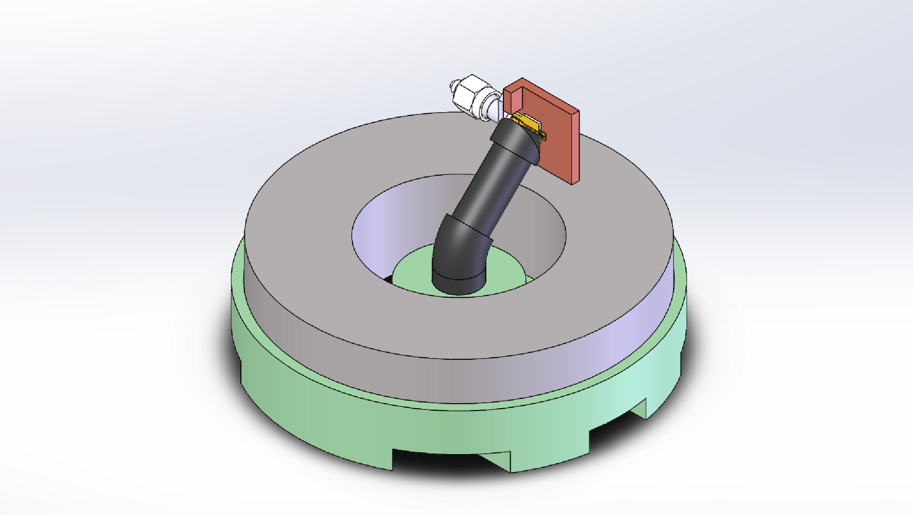
Given Requirements
The spiral mixer is required to move between 1mm to 6mm away from the magnet pole.
This is how the mixer detects change in the magnetic field.
Fit in cylindrical volume of 8.34 inches in diameter and 3.25 inches tall.
To cool down the assembly, it is placed in a cryostat, which has limited space.
All parts must meet correctly and move as needed when cooled to sub 20K temperatures.
The only was to get a superconductor is to supercool it.

Slide 4
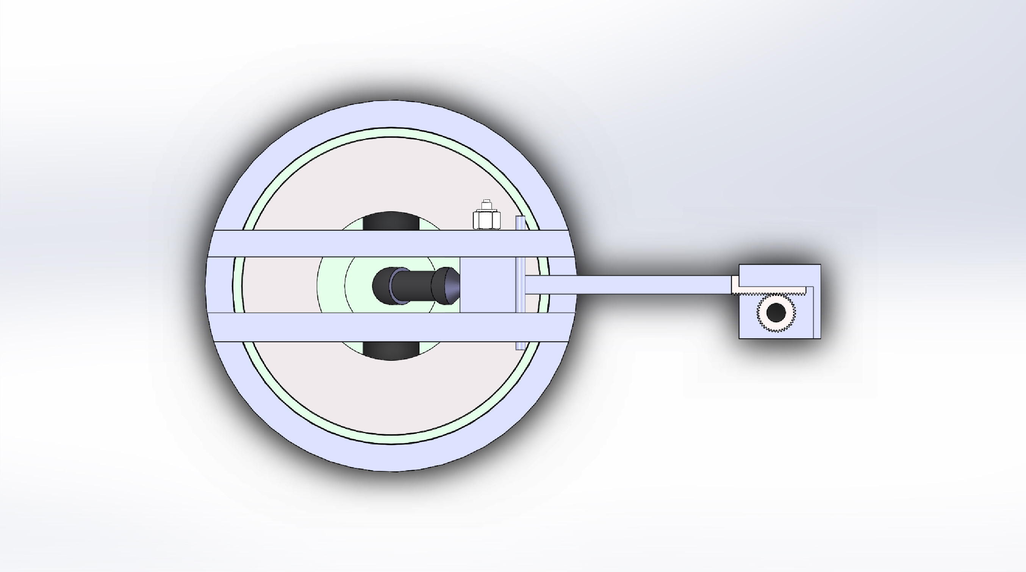
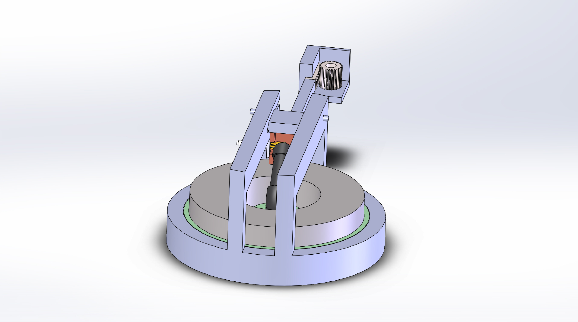
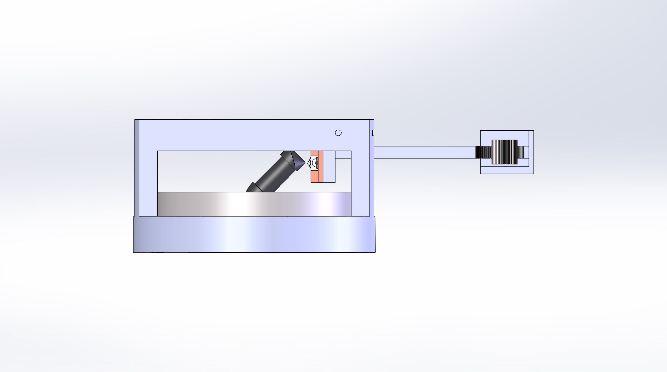
Movement
I chose a rack and pinion for the assembly
Transfers rotation 90° from the top to lateral motion of the spiral mixer.

Slide 5
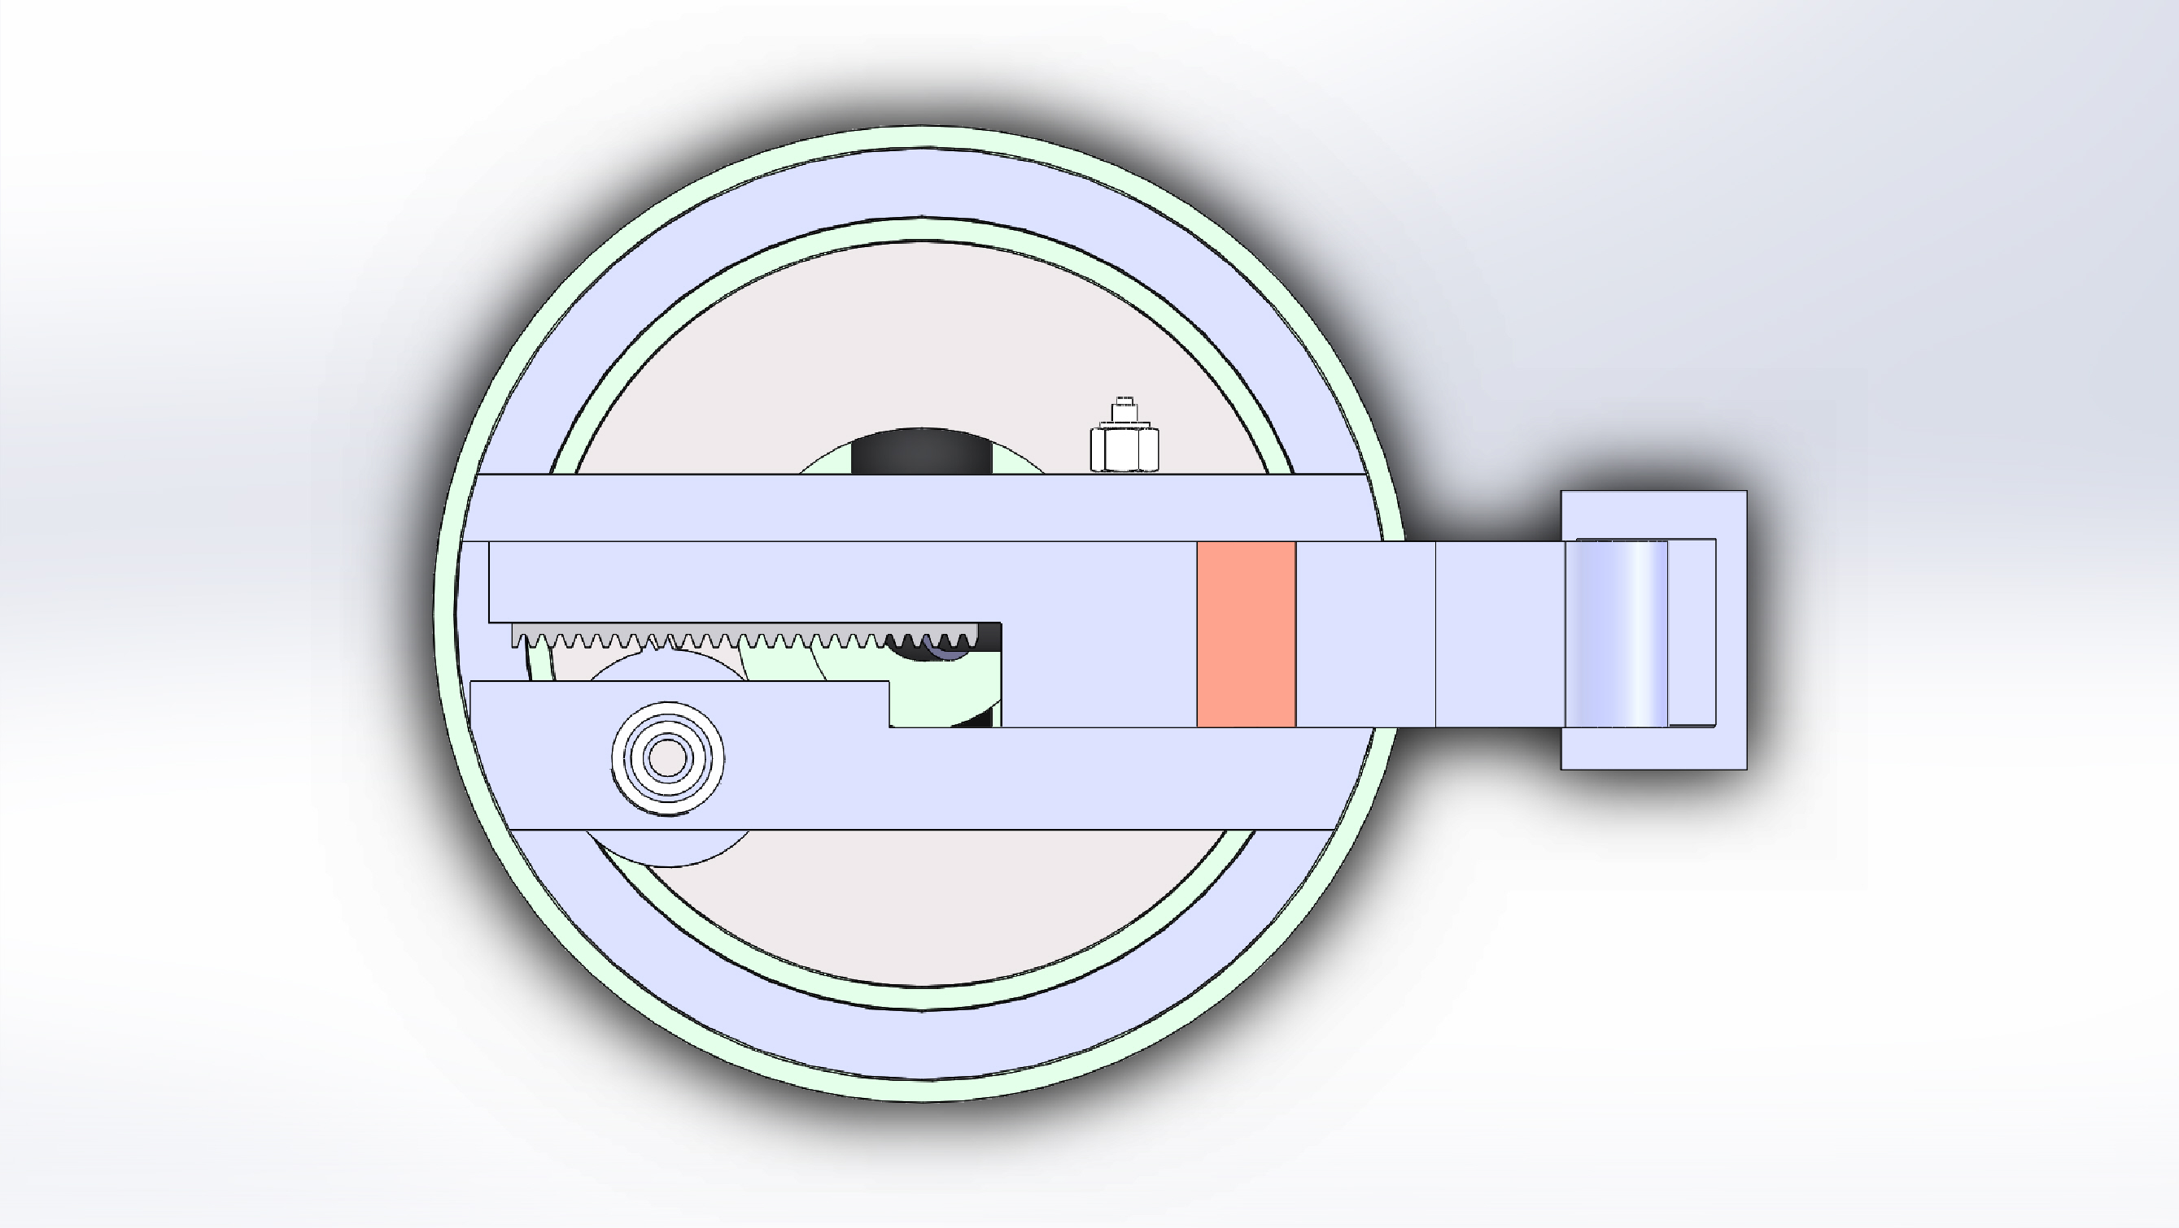
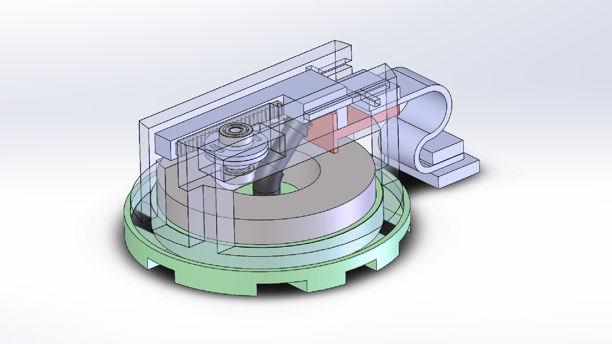
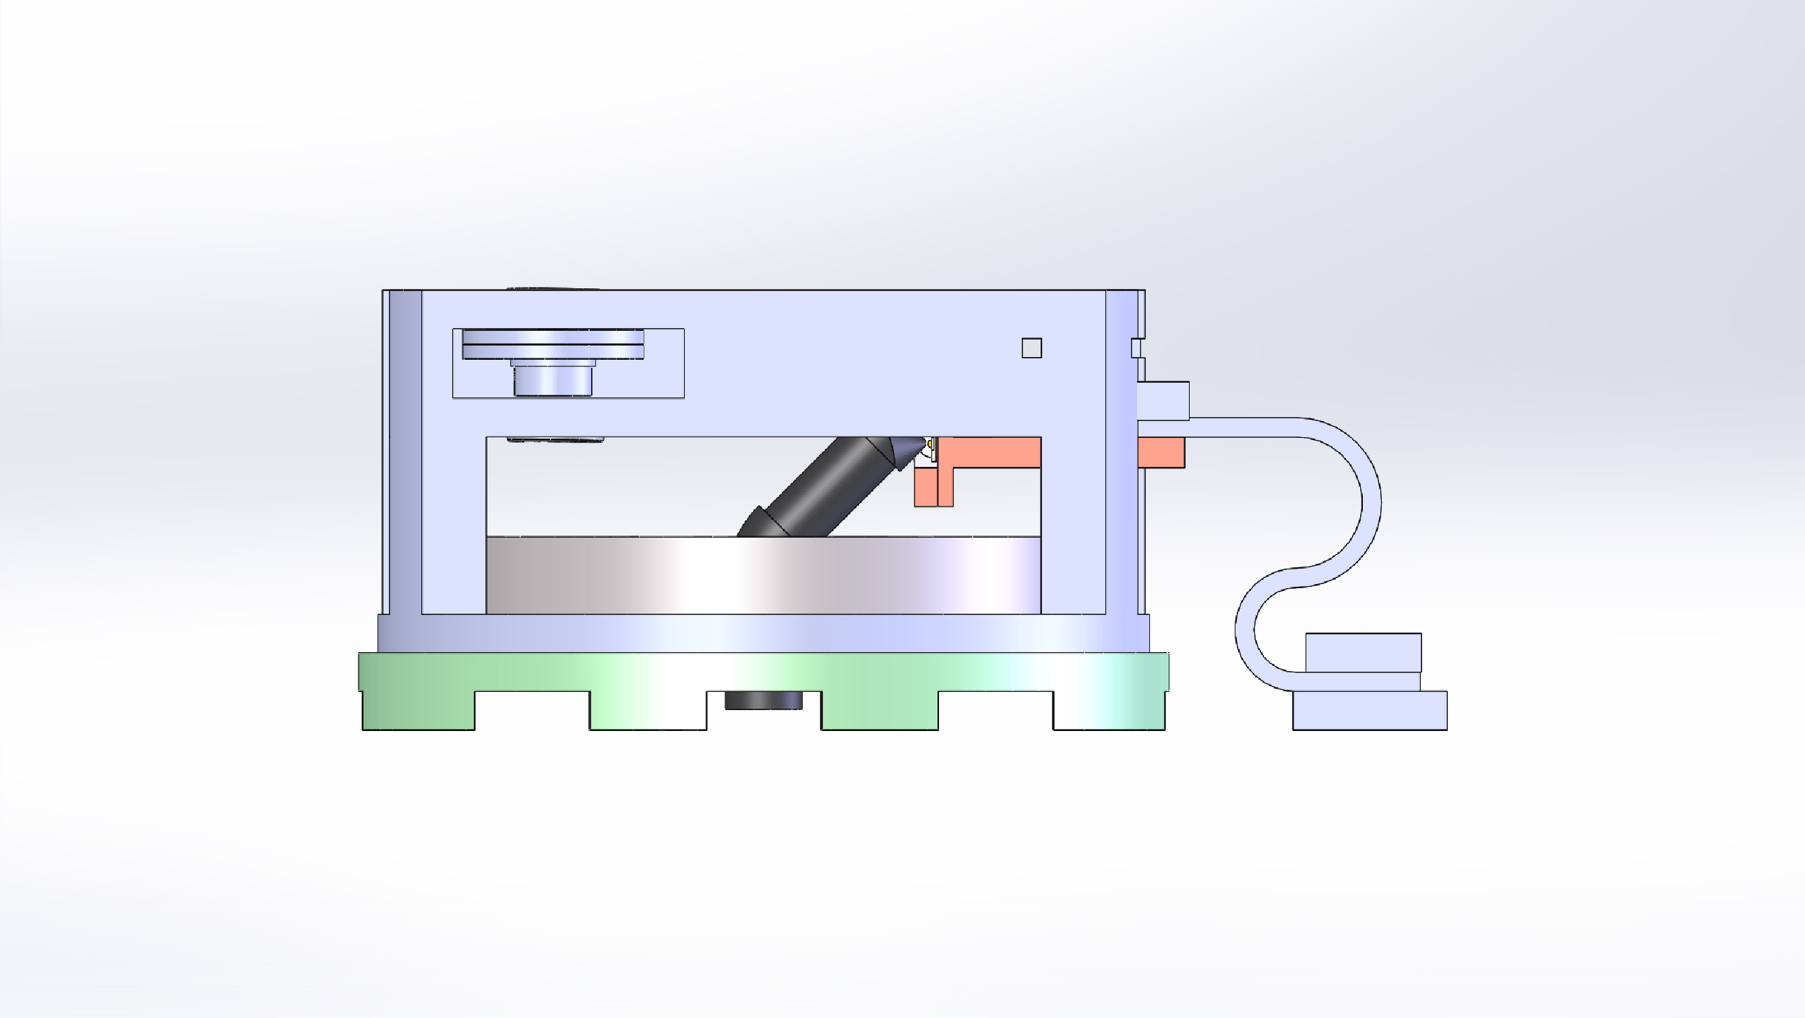
Condensing
I moved the rack and pinion to the center to condense everything.
This allowed me to add a thermal strap to the back of the spiral mixer.
The thermal strap draws heat away from the electrical components down to the 4K plate.

Slide 6
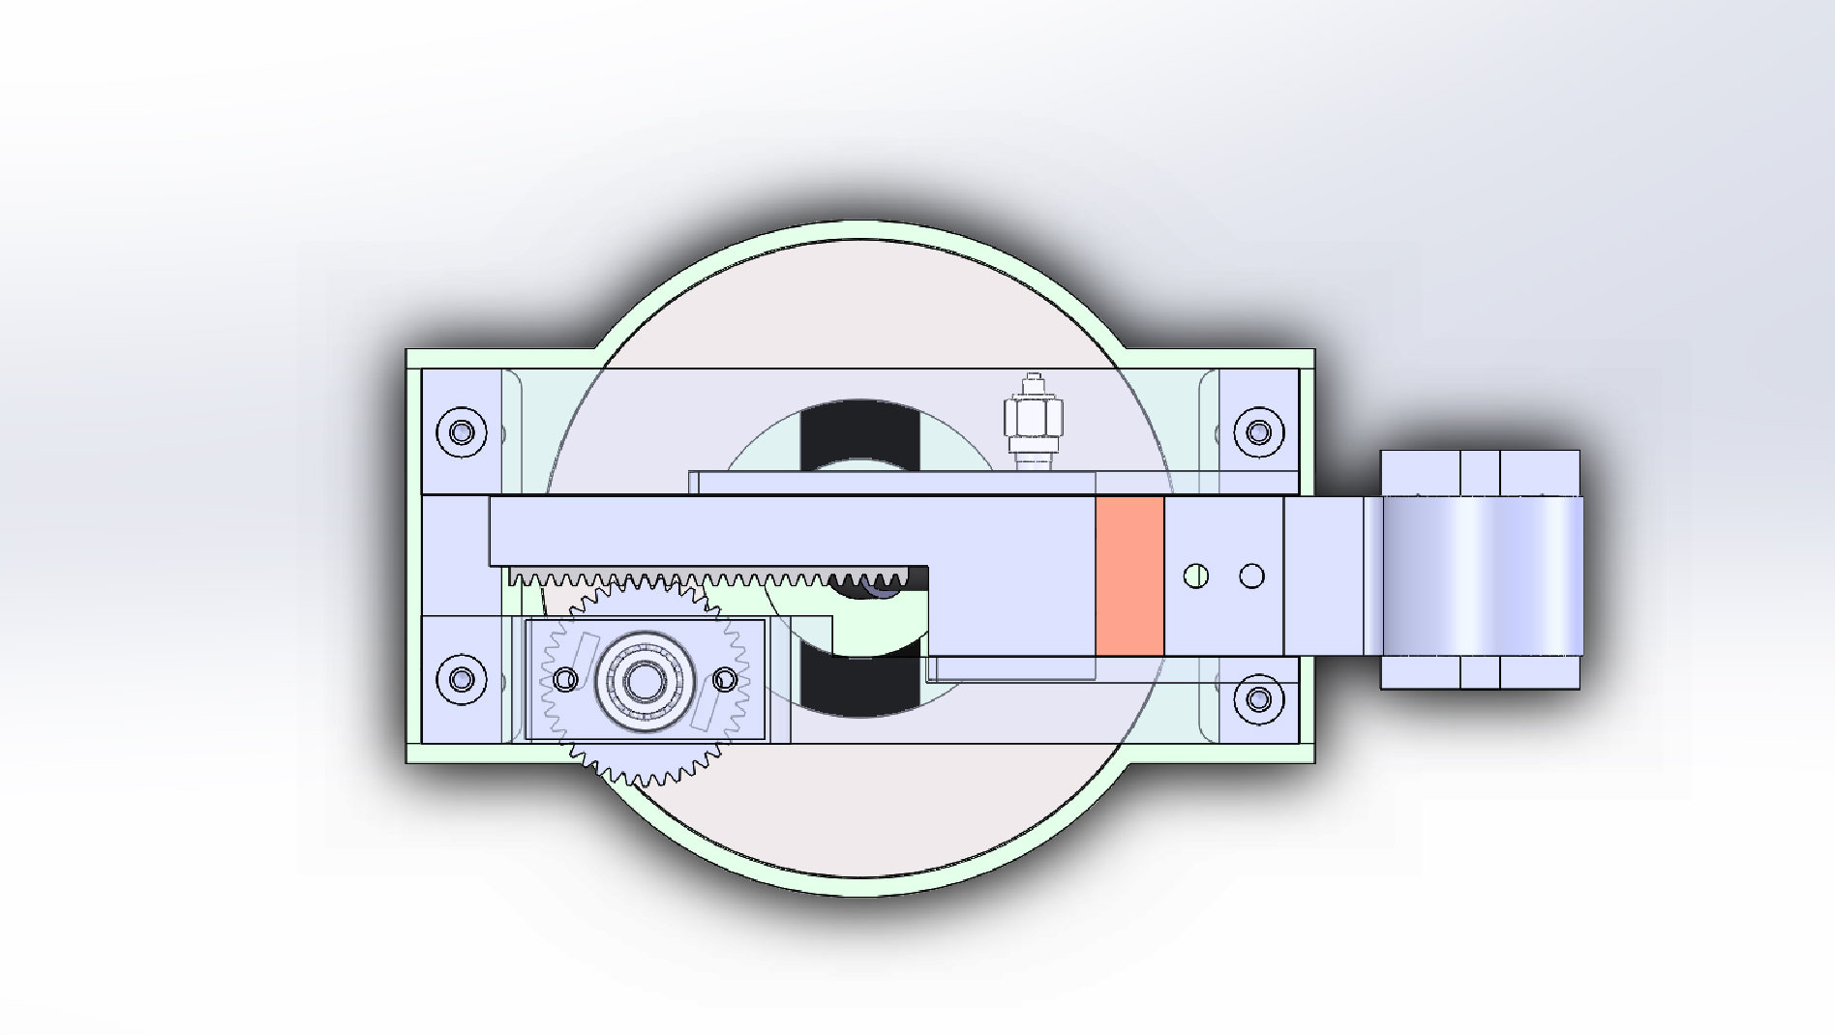
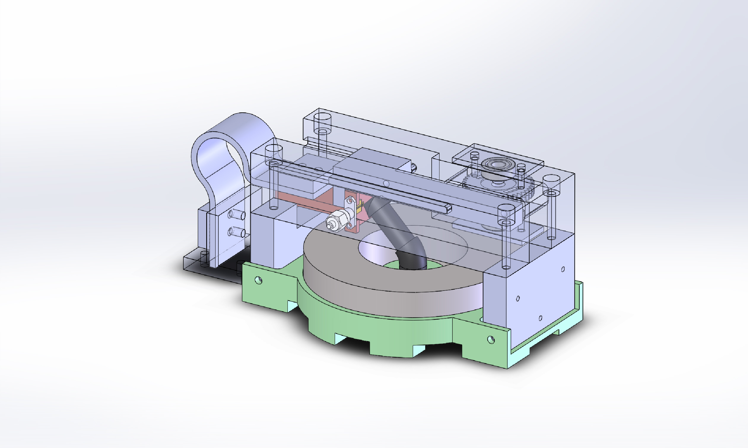
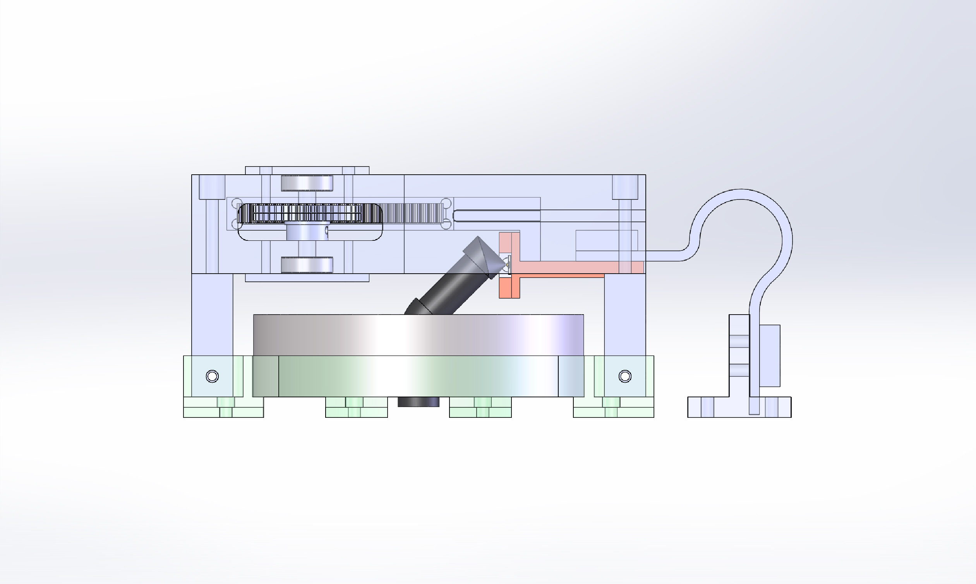
Ease of Assembly
Making it easy to assembly was important
I simplified the main scaffold into four rectangular pieces.

Slide 7
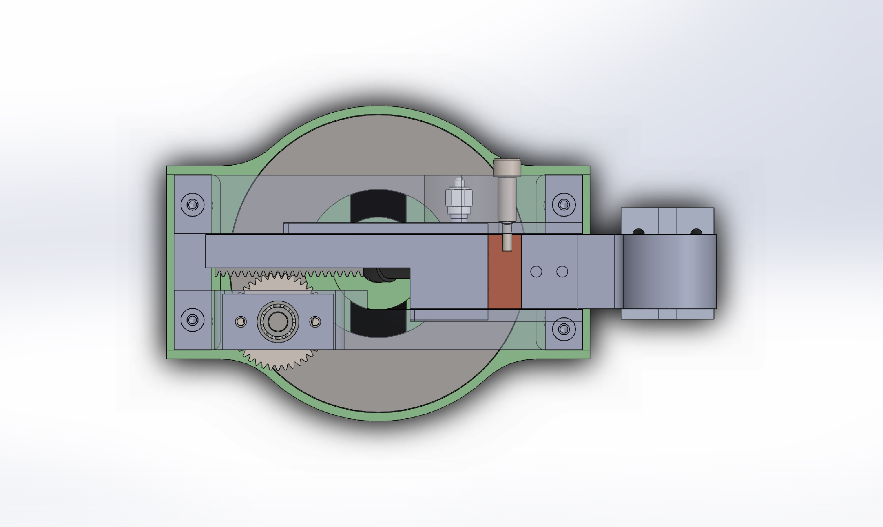
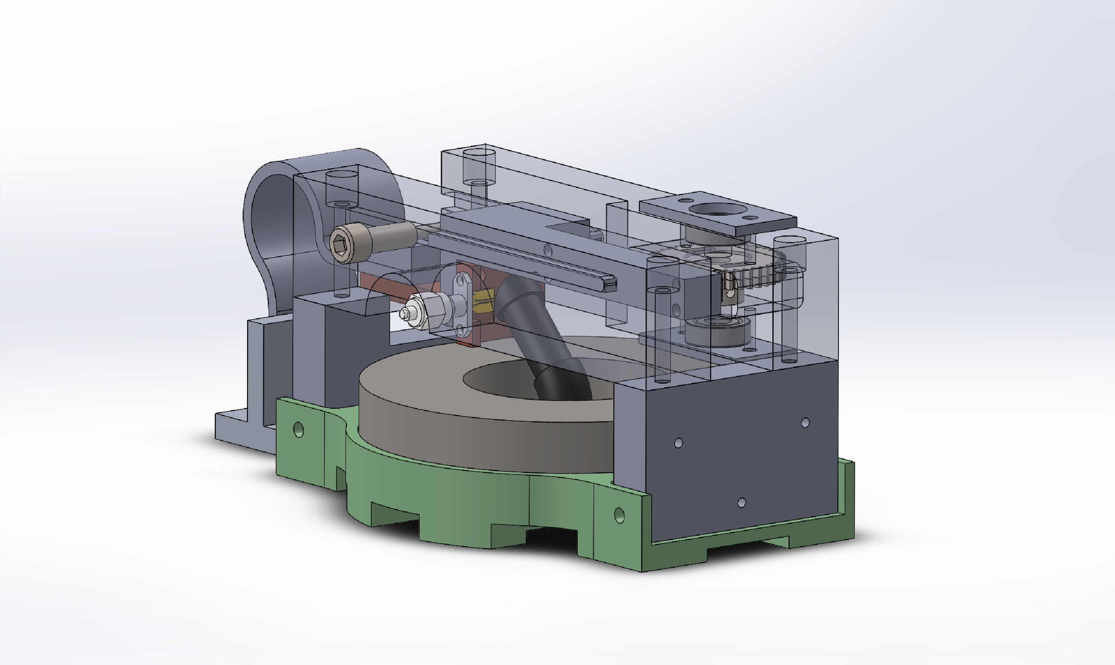
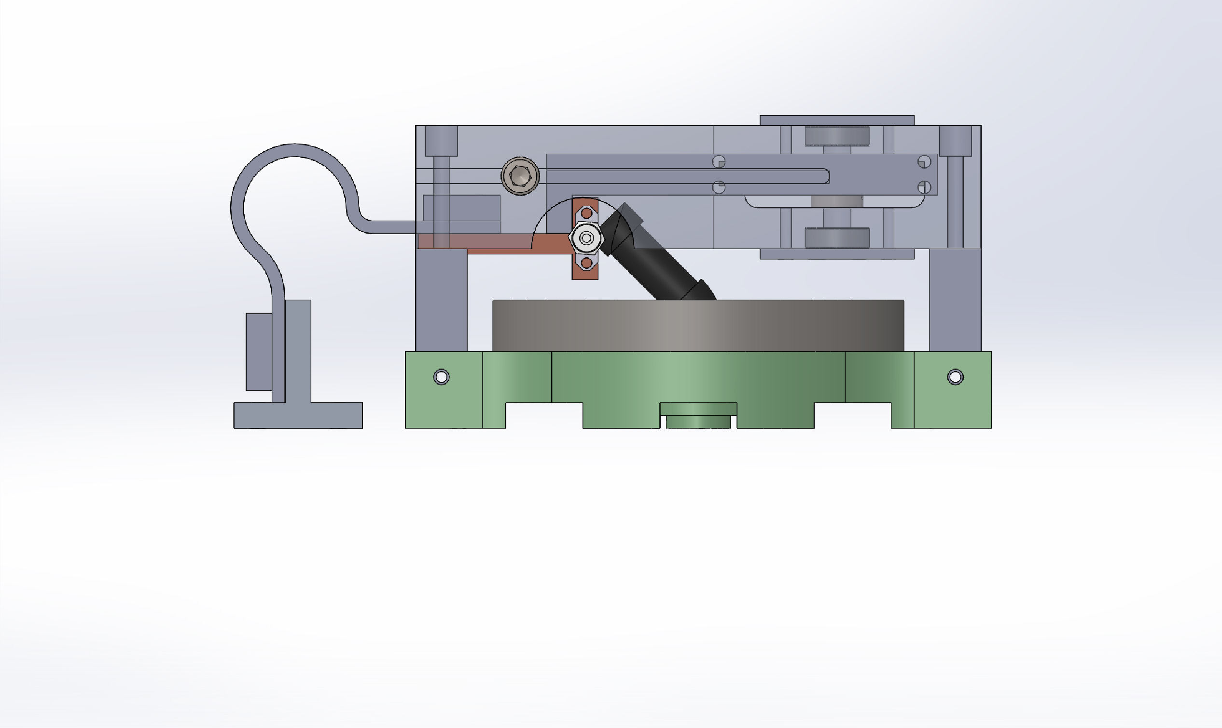
Thermal Contraction
Thermal contraction is the amount a material shrinks when cooled to low temperatures.
All parts have to be analyzed with relation to the others.
The main structure is aluminum, with some steel, copper, and G10.
Some of the measurements needed hundredths of an inch adjustment.

Slide 8
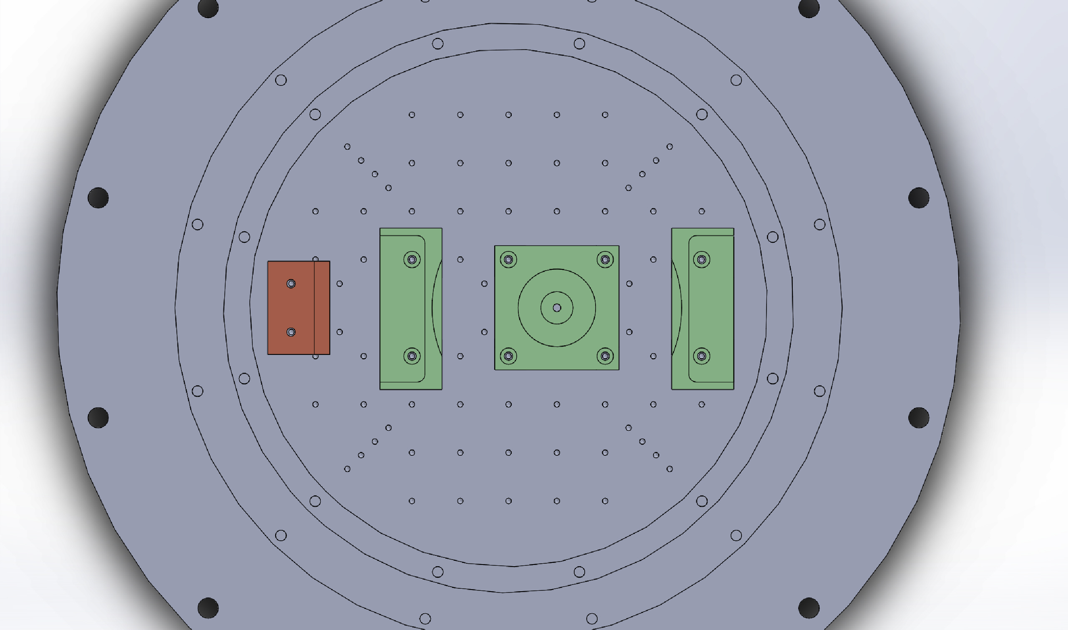
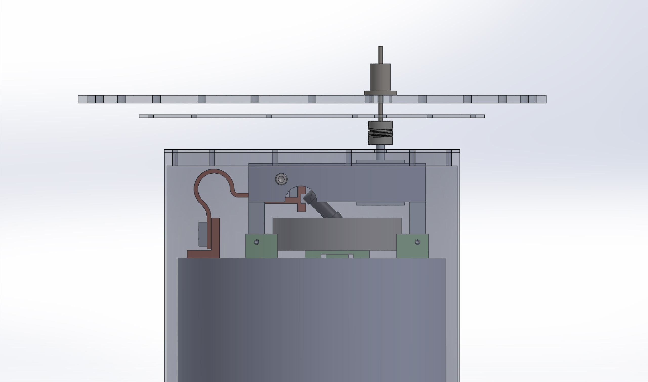
Bolting Down
I also made a simple model of the cryostat that the MET assembly will be going into.
This helped to find where to make holes in the base and thermal strap plate so they can be attached to the 4K plate.
This also helped find where to make holes in the radiation shield covers for the shaft coupling

Slide 9
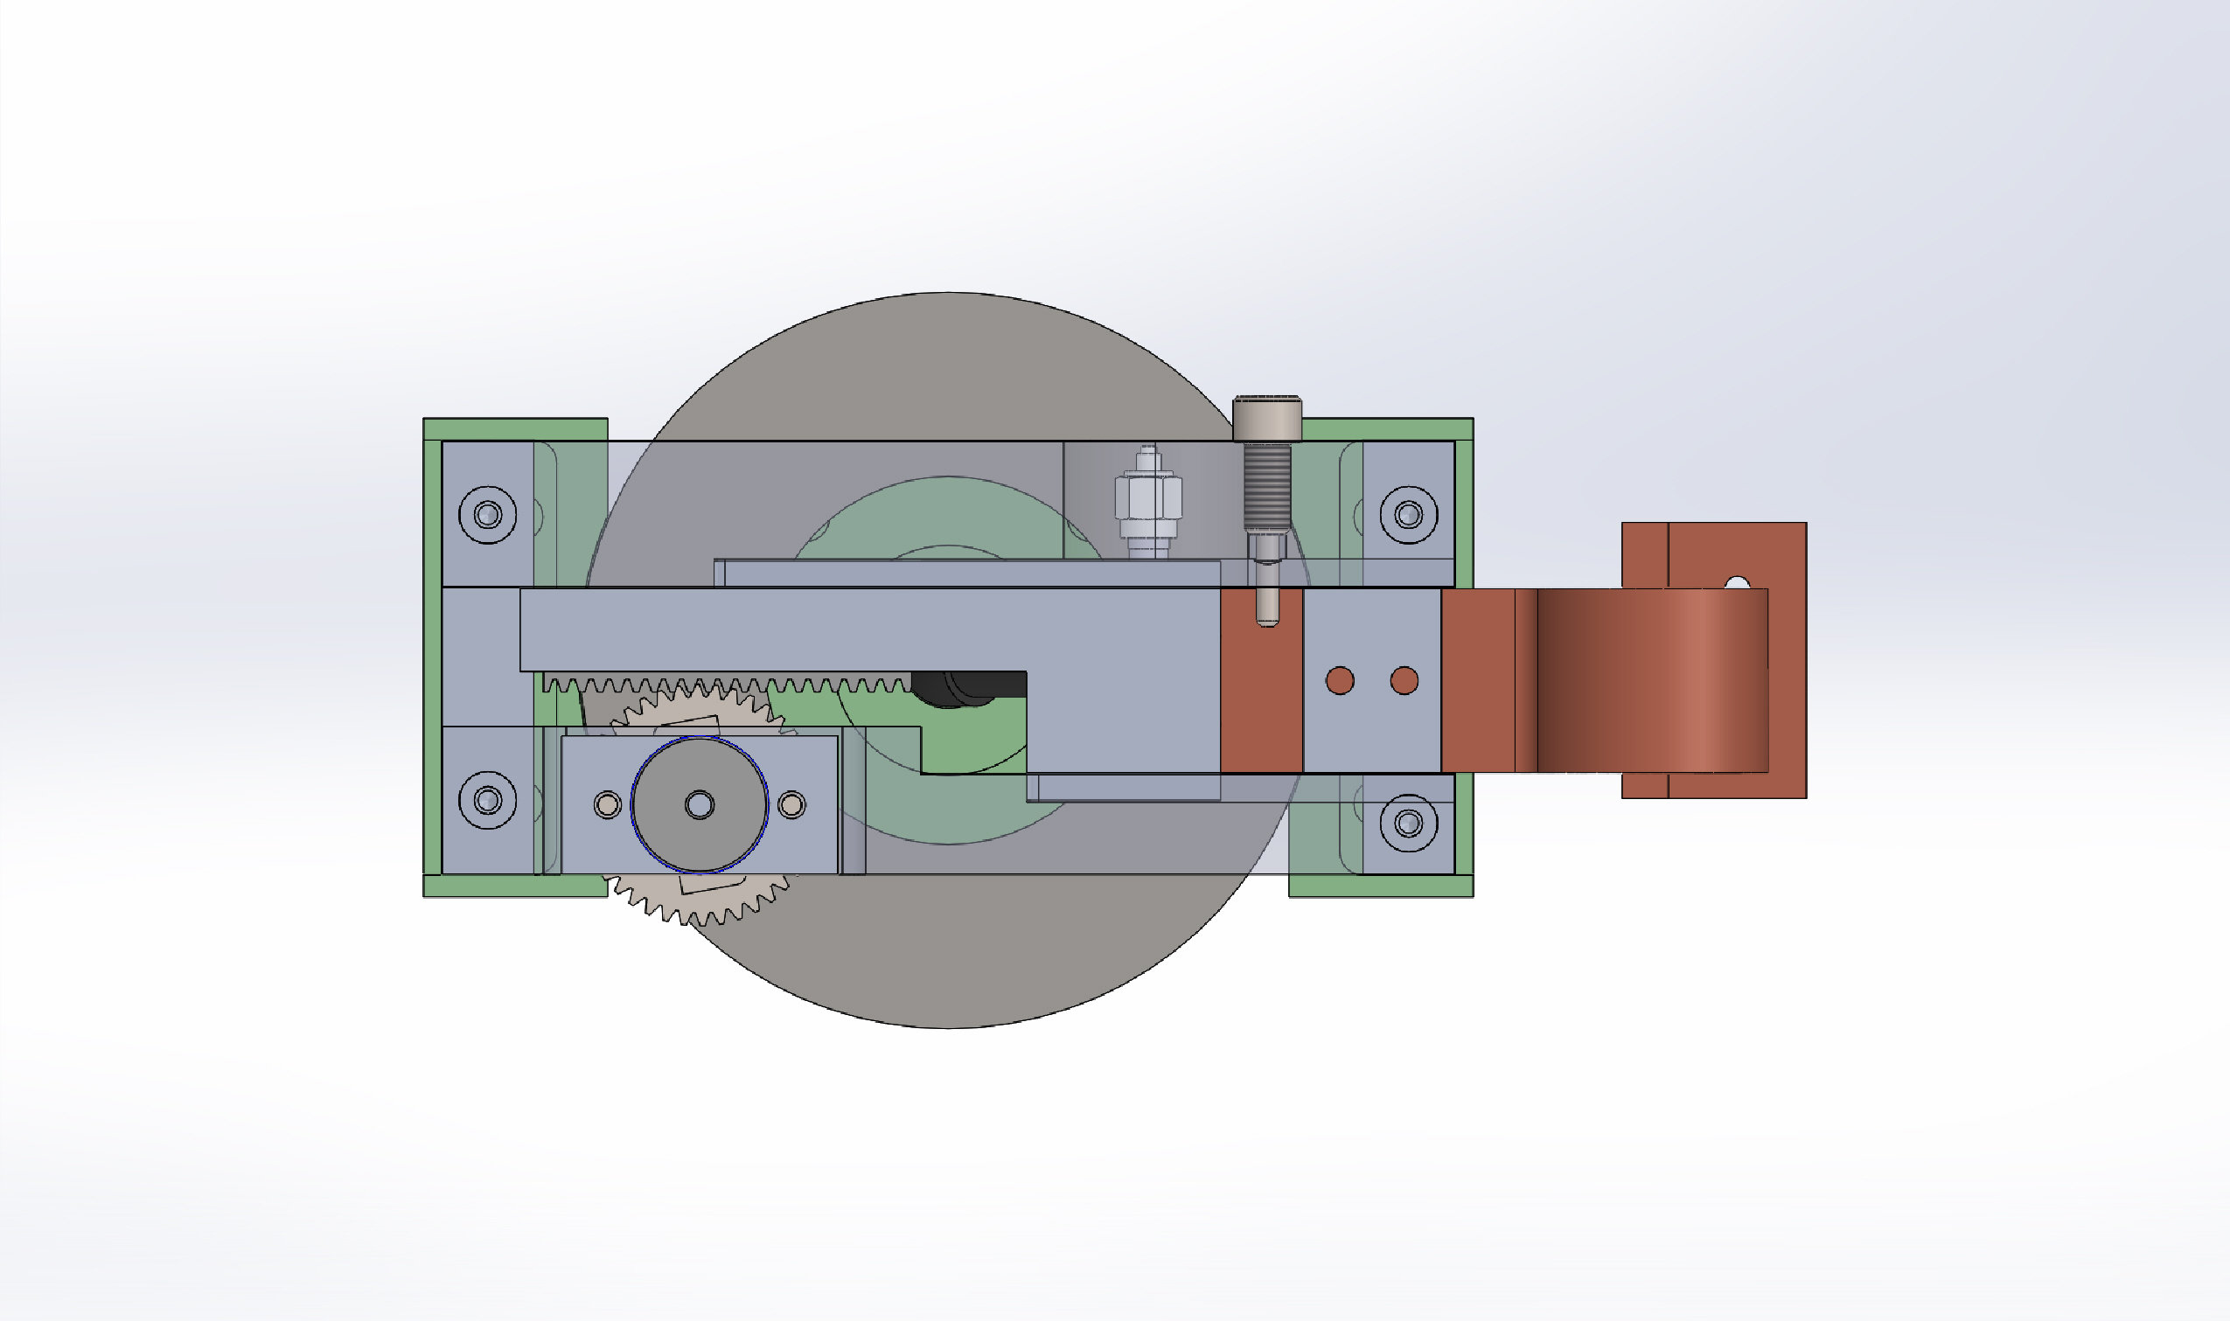
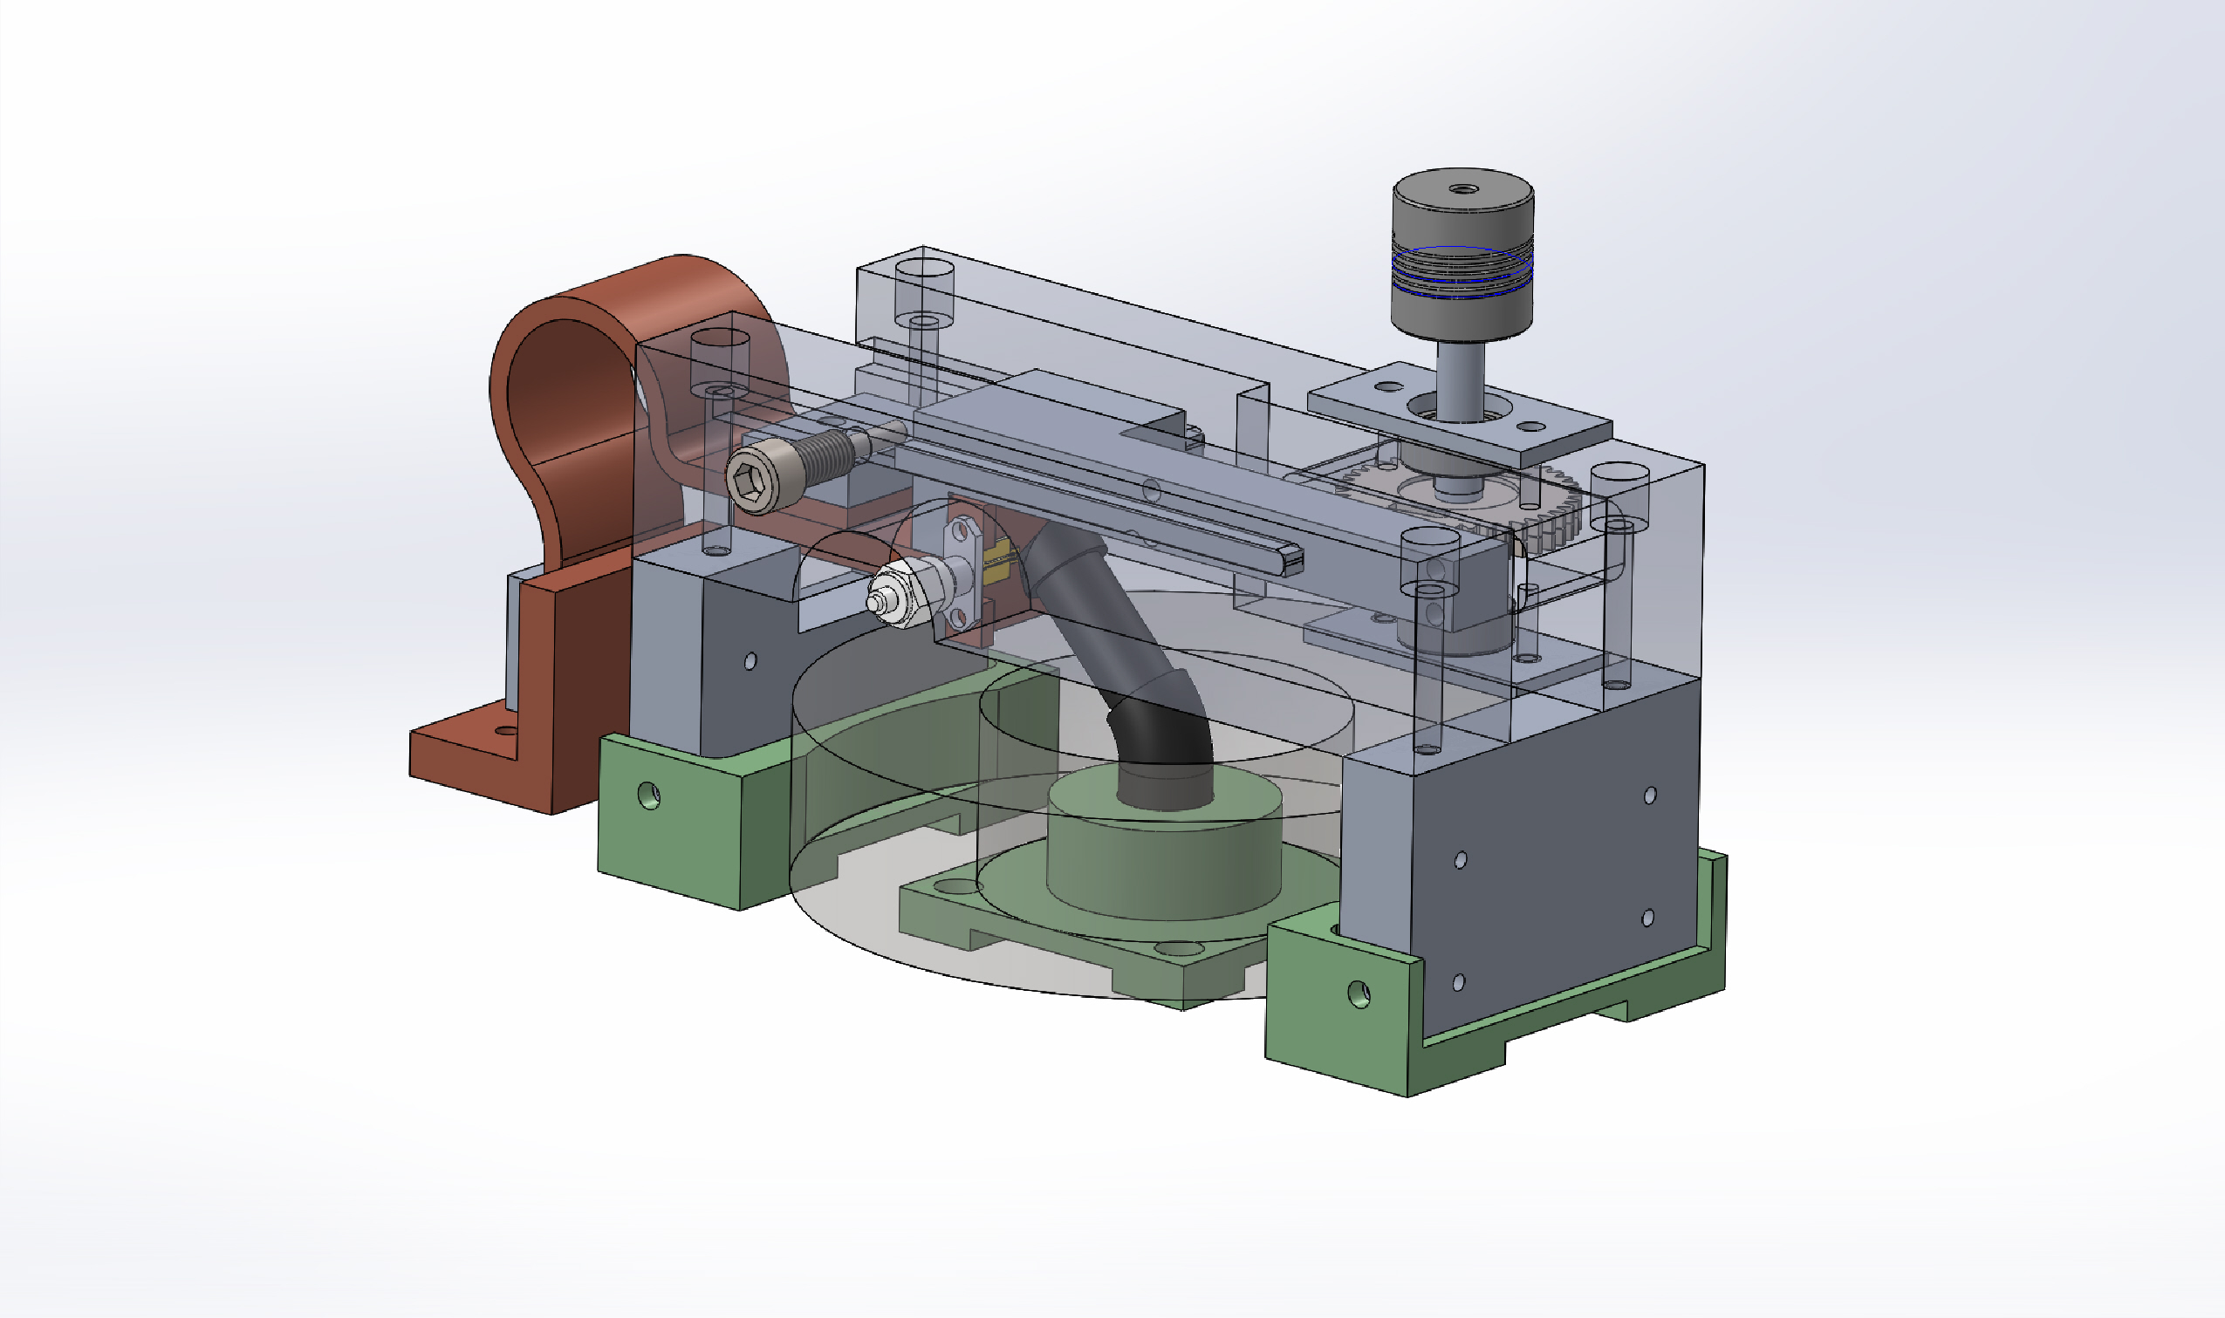
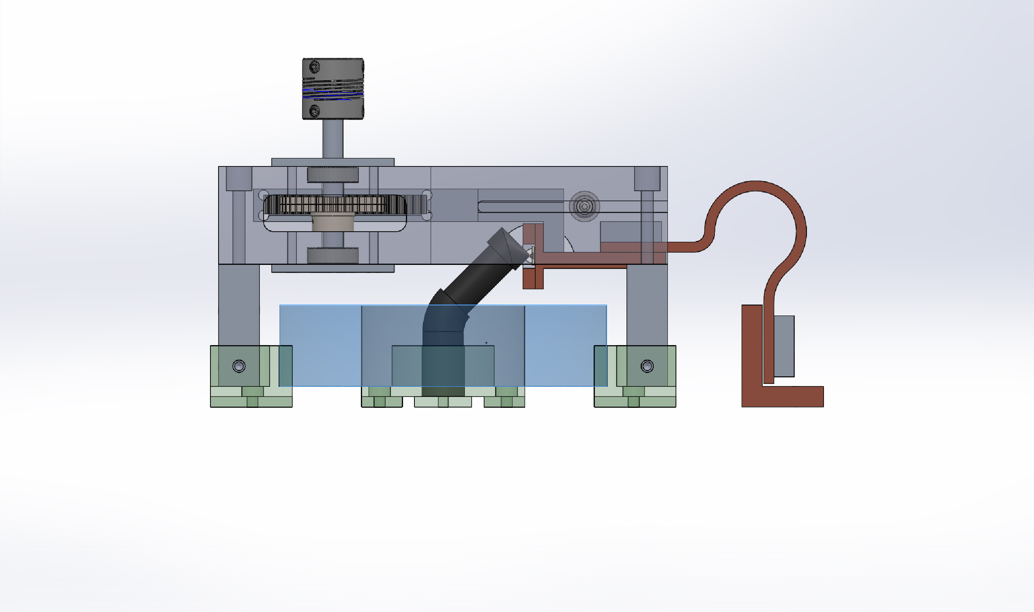
Finalizing
Once finalized, I had to estimate the cost of all the parts. From the made parts and the parts that need to be manufactured.
I made drawings to send out for machining the parts
After some discussion, the G10 base was changed to simplify the part and bring down the cost of machining.
I did thermal analysis to account for the change and made new drawings for the affected parts.

Slide 10
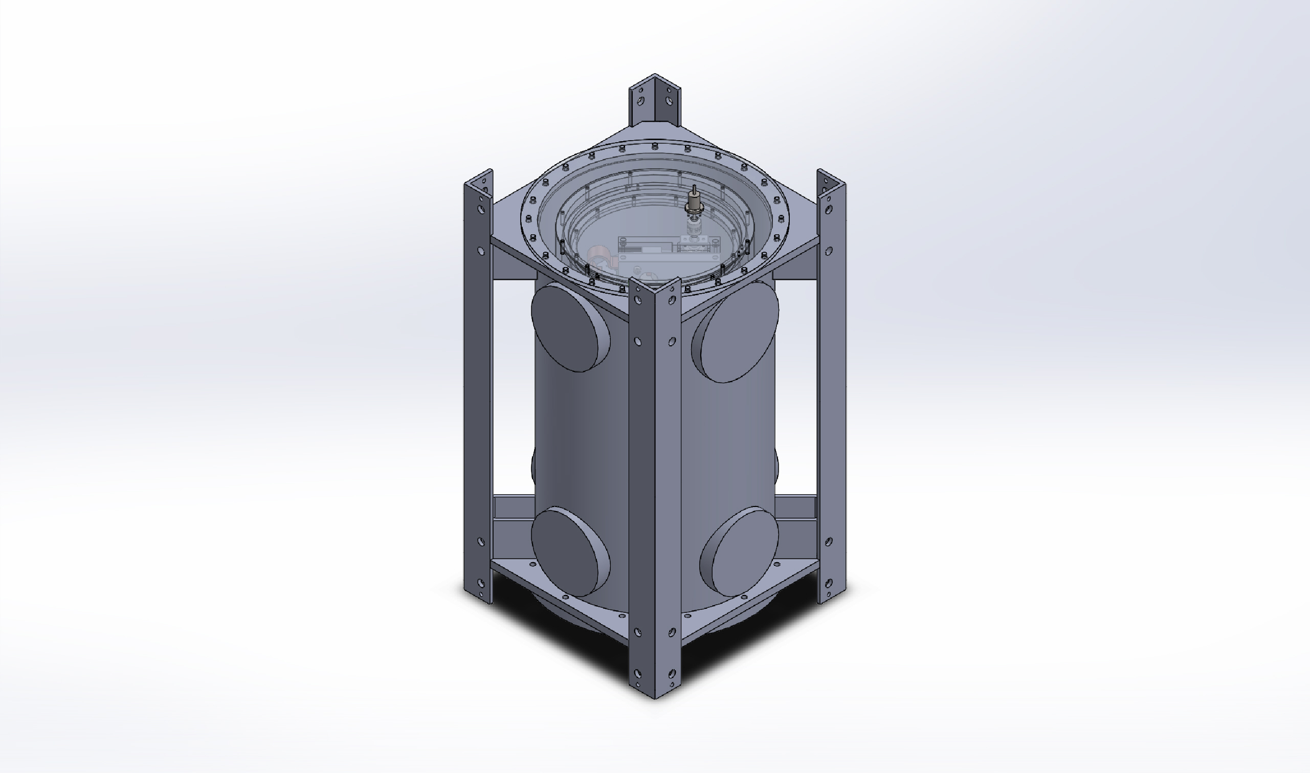
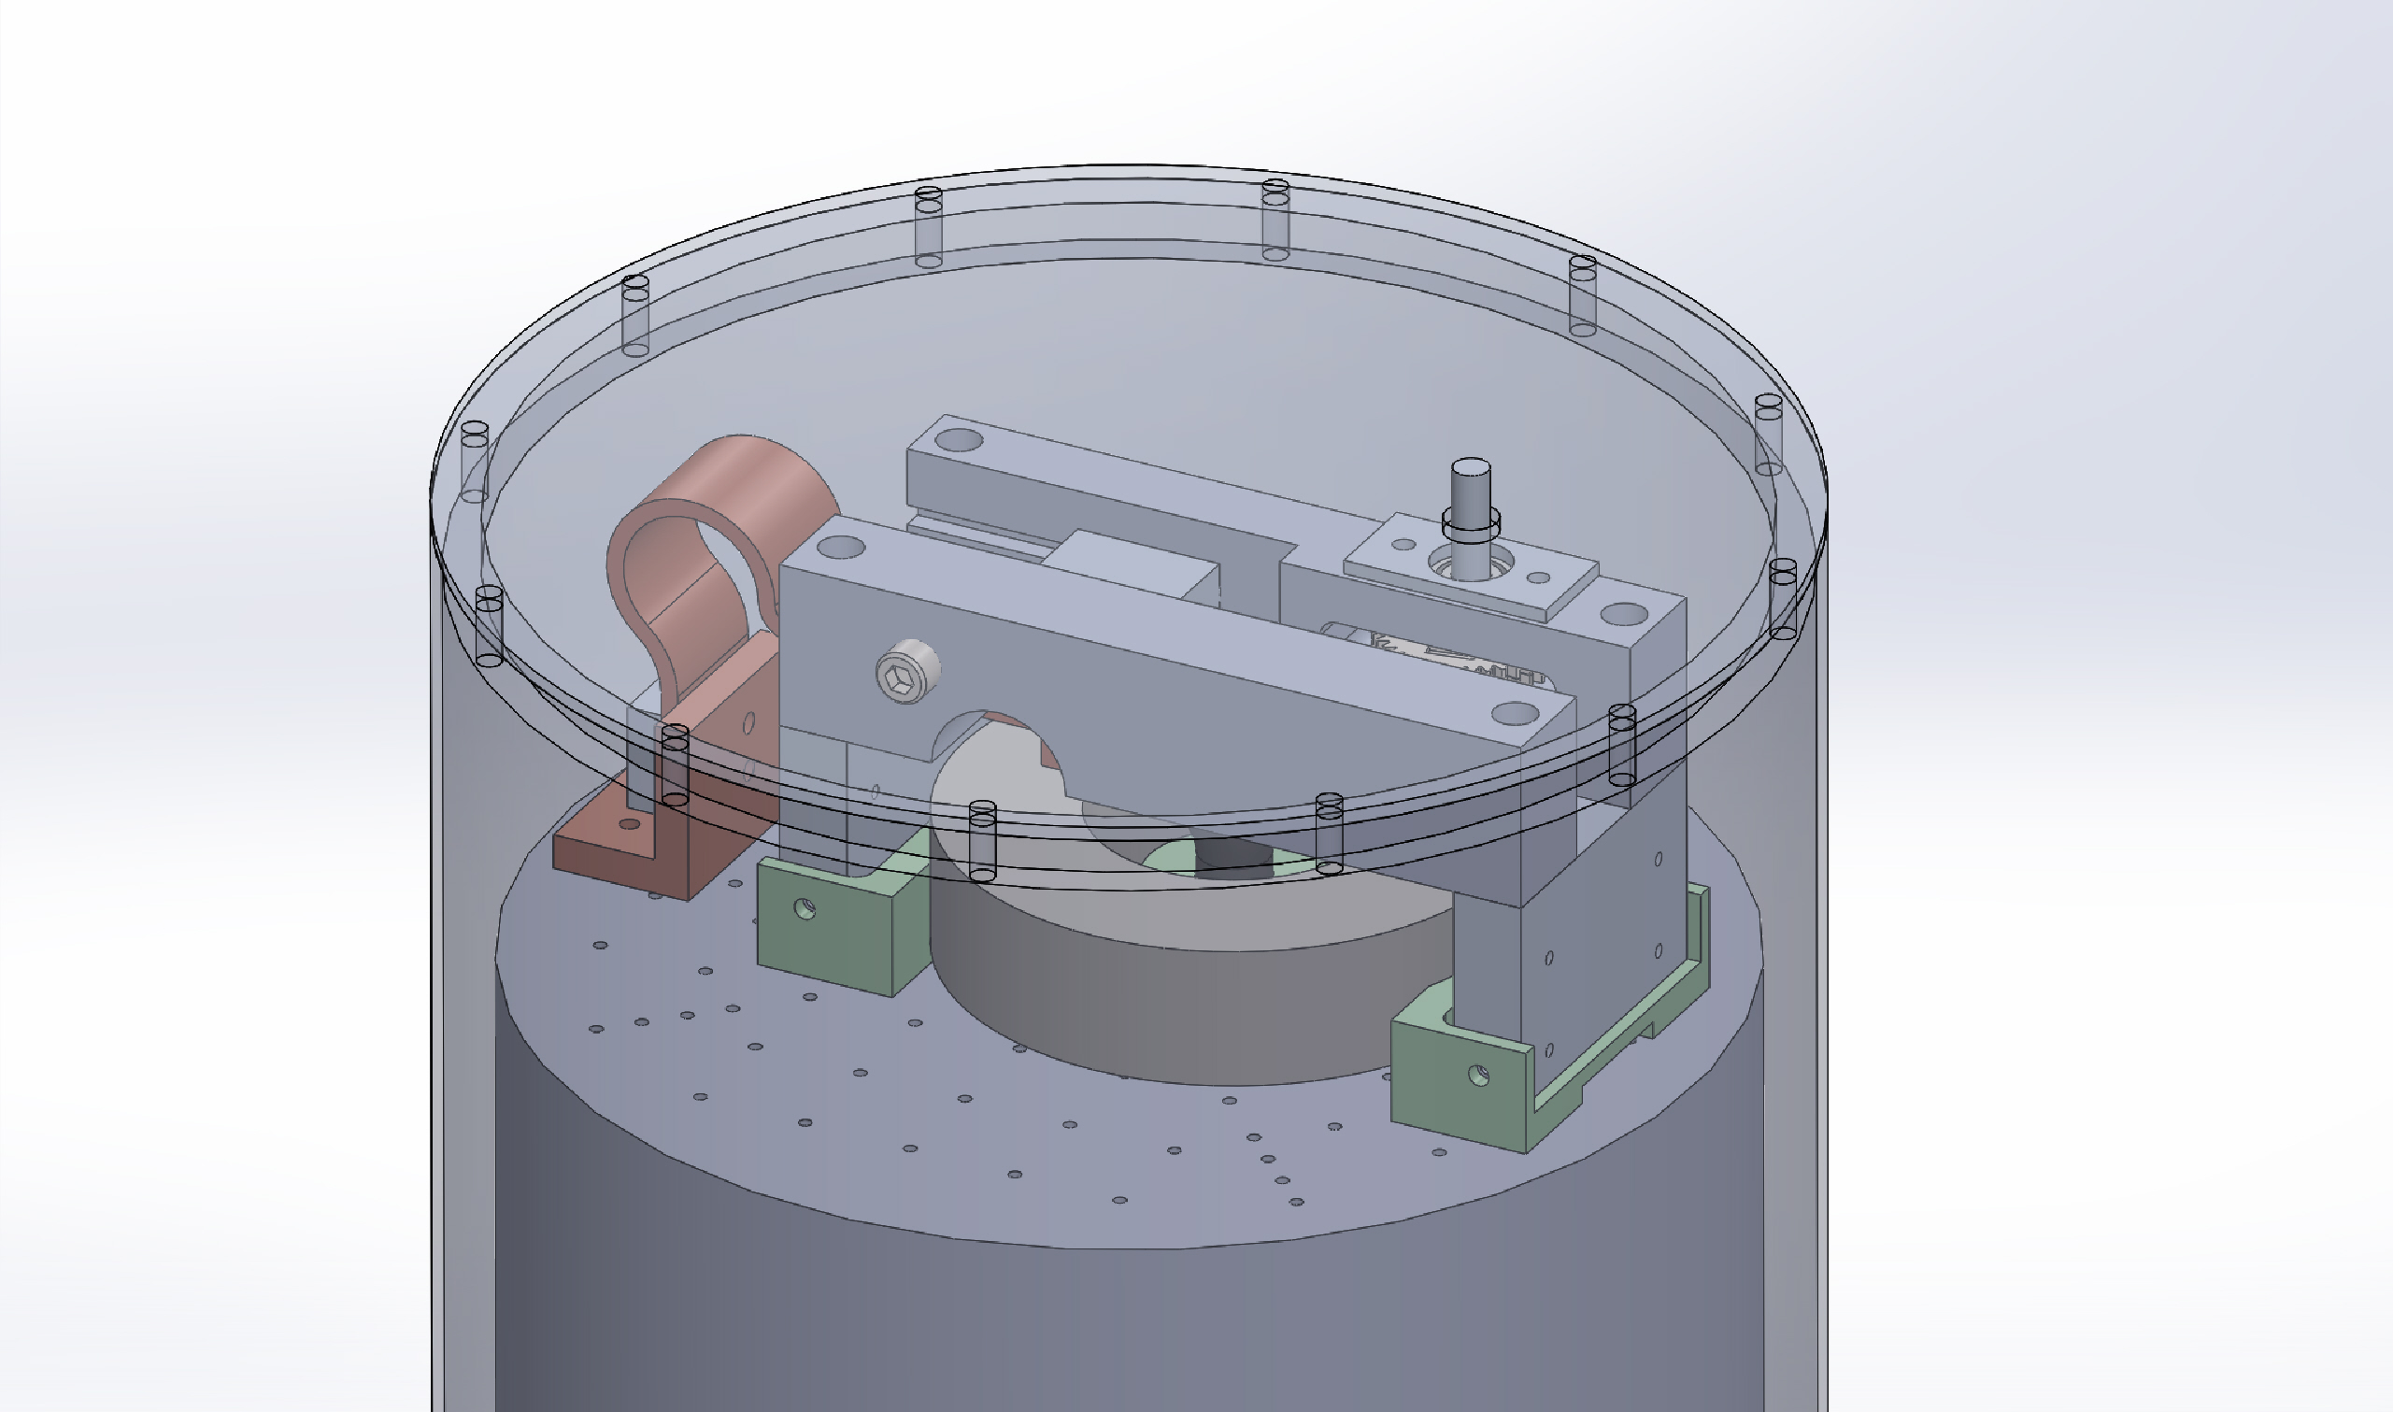
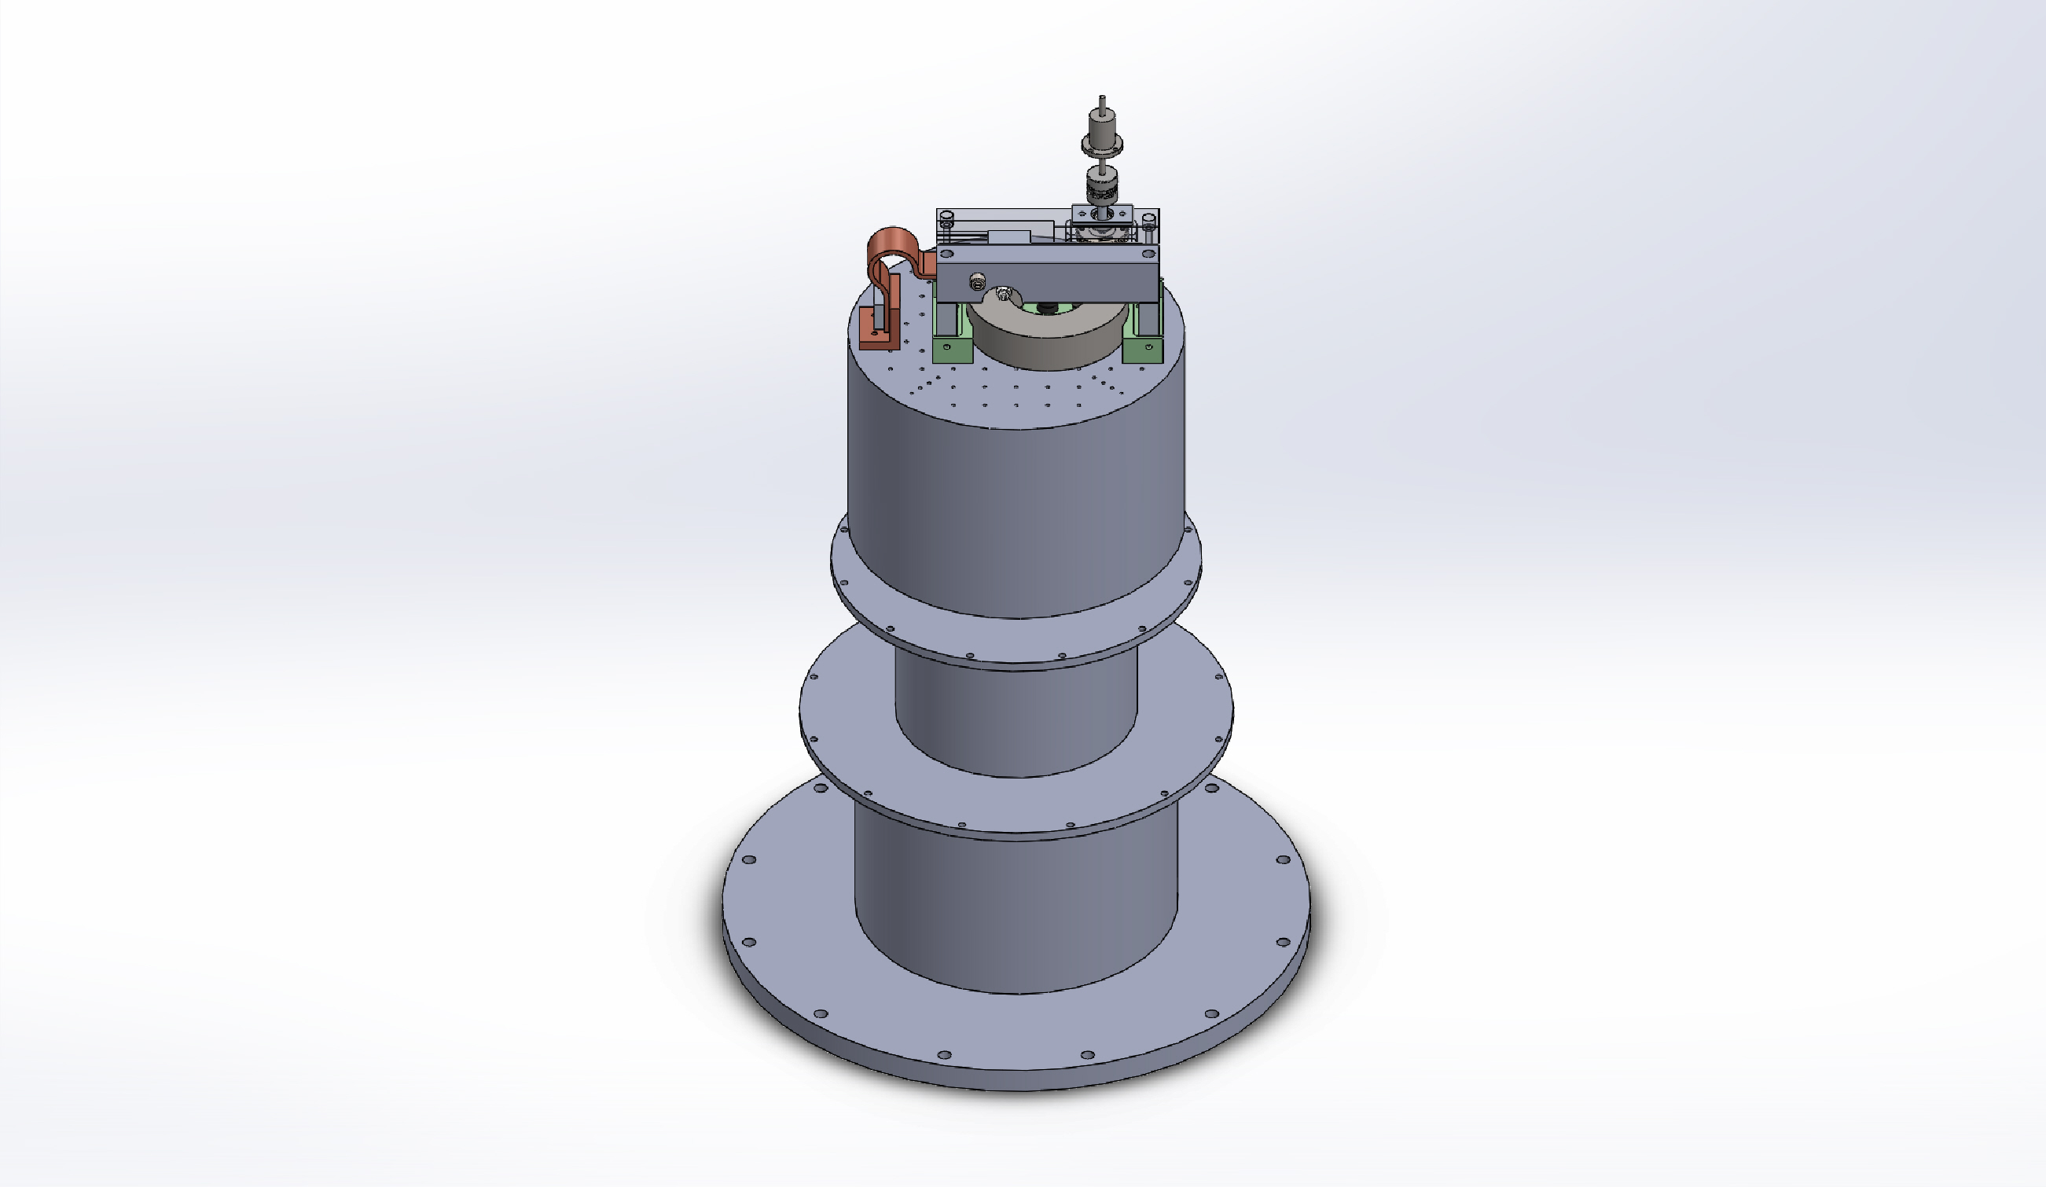
Thank you

